Slide 1
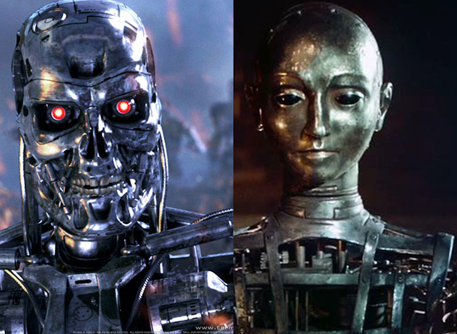
Theory Of Automata
1
Notes:
<number>

Slide 2
Lecture # 06
Theory of Automata
2

Slide 3
Revision
Concatenation of strings
Language Concatenation
Union of strings
Regular expressions
Conversion of string in to Regular expressions
Examples of RE
2

Slide 4
1:Concatenation of Strings
◦ is the concatenation operator
Example:
Suppose w1 and w2 are two strings
w1 = abc, w2 = def
w1 ◦ w2 = abcdef
w2 ◦ w1 = defabc
w2 ◦ w2 = defdef
Often drop the ◦: w1w2 = abcdef
For any string w, w €= w [€ = empty string]
4

Slide 5
We can concatenate a string with itself:
w¹ = w
w² = ww
w³ = www
By definition, w⁰ = €
Can reverse a string: w^{R}
abcde^{R} = edcba
4

Slide 6
Language Concatenation
We can concatenate languages as well as strings
L1L2 = {wv : w ∈ L1 ∧ v ∈ L2}
Example:
{a, ab}{bb, b} = {abb, ab, abbb}
{a, ab}{a, ab} = ?
{a, aa}{a, aa} = ?
What can we say about |L1L2|, if we know |L1| = m and |L2| = n?
4

Slide 7
We can concatenate a language with itself, just like
strings
L¹ = L, L² = LL, L³ = LLL, etc.
What should L⁰ be, and why?
4
Notes:
<number>

Slide 8
L⁰ = {€}
{} is the empty language
{€} is the trivial language
Kleene Closure (L)
L* = L⁰ ∪ L¹ ∪ L² ∪ L³ ∪ . . .
4

Slide 10
2: Union of Strings
Use of OR (+) operator for regular expression:
a|b = a or b = (a+b) = {a,b} = {a} U {b}
(a|b)* = (a or b) 0 or more times
(a|b)⁺ = (a or b) 1 or more times
a|b* = a or b (only b 0 or more times)
(a|b)*(c|Λ) = (a or b) 0 or more times and c or Null string
Note: {a,b} is not a R.E
10

Slide 11
Conversion of strings into Regular Expressions
Convert the following into a Regular Expression.
1: {a,bc} = (a +bc )
2: {1,11,111,1111,……} = 1(1)*
3: {a,ab,b,bb} = (a+ab+b+bb)
= a(1+b) b(1+b)
4: {a,ab,abb,abbb,abbbb,……..} =ab*
11

Slide 12
Regular Expression Examples
Expand the following R.E.
1: (a+b)* = {Λ,a,b,aa,ab,ba,bb,aaa,aab,aba,…}
2: (a.b)* = {ab,abab,ababab,…….}
3: ((a*).(b*)) = {Λ,a,b,aa,ab,bb,aaa,aab,abb,
bbb,...}
12

Slide 13
4: ((a+b)(b*)) = {a,b,ab,bb,abb,bbb,abbb,bbbb,….}
5: (( (a+b)(b*))a) = {aa,ba,aba,bba,abba,bbba,….}
6: (a( (a+b)*)a) = {aa,aaa,aba,aaaa,aaba,abaa,abba,…….}
12

Slide 14
Define a Regular expression for language that contains all of the strings of a and b
L= {a,b,aa,ab,ba,bb,aaa,aab,aba,abb,bbb,….}
For the above strings the RE will be
(a+b)*
12

Slide 15
Define a Regular expression for language that contains substring ba
L= {abaa,abab,bbaa,bbab,aabaa,abbaa….}
For the above strings the RE will be
(a+b)* ba (a+b)*
12

Slide 16

Lecture Summary
Examples of R.E
16

